Slide 1
CMP206: Programming for the User Lecture 5: Users, Activities, Environment, Design Goals & Principles
Dr Andrea Szymkowiak (shtas@abertay.ac.uk)
Dr Gavin Hales (gavin.hales@abertay.ac.uk)

Slide 2
Users
are very good at finding patterns in complex interactions or working with patterns
have a better memory when they are able to chunk or group items (7±2 items)

Slide 3

Users
are very poor at paying attention (monitoring) the state of something for long periods of time
have limited attentional capacity https://www.youtube.com/watch?v=IGQmdoK_ZfY

Slide 4
Design
Users: Models, Affordances, Gestalt principles
Activities
Environment
Goals and Principles

Slide 5
Activities
Which activities are common/repeated
Is there a time limit or specific sequence
Do the users share a special jargon
Are any activities potentially unsafe or risky
Will any of the interactions on our product be novel to the users, e.g., shake to shuffle
Have the users been trained
…
Knowledge of what the users will be trying to do with our design is again of obvious interest
What do you think you need to know about user activities?

Slide 6
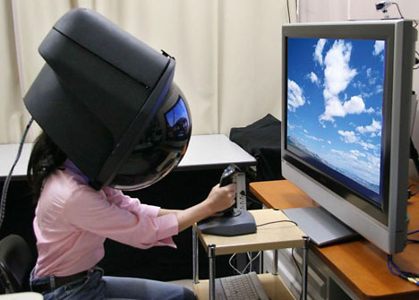
Activities
Interaction styles:
Before we start sketching designs we must also consider the type of interaction that is most appropriate to the product
Instructing
Conversing
Manipulating
Exploring (virtual & ambient)

Slide 7
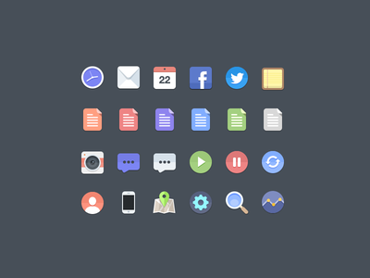
Instructing
The user issues instructions to the system as text input or by selecting icons or menu items or function keys, speaking, gesturing etc.
The system responds with the appropriate action or an error message
https://dribbble.com/shots/1054478-Free-Flat-Icons

Slide 8
Conversing
We engage in a dialogue with the system which attempts to understand our input – text or spoken, e.g., search engines or agent based enquiry systems (e.g. Siri)
In this way we do not issue commands, but rather questions or statements
This has the potential to be a massive growth area
But it may also cause lots of frustration / dissatisfaction / annoyance

Slide 9

Remember Clippy? Or ever heard of Clippy?
It looks like you’re writing a letter.
Would you like help?
Get help with writing the letter
Just type the letter without help
_________________
What are you lookin’ at?
I knew from the time you clicked “Help” you were gonna be a problem.
What’s wrong? Paperclip gonna make you cry?
Cancel

Slide 10

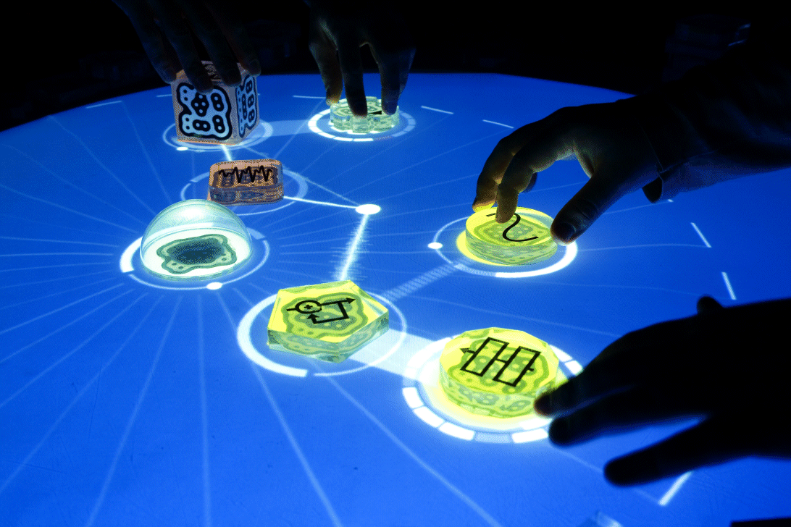
Manipulating
Users interact with objects in virtual or physical space
Capitalizes on users’ knowledge on how to interact with physical object
But also extends this, e.g., zooming in/out
The objects may be very simple and are tracked by a central controller or the objects themselves may contain sensors and processors and act autonomously

Slide 11

Exploring
We are immersed in or move through a virtual environment or physical space
Interaction is usually through gesture or handheld devices

Slide 12
Design
Users: Models, Affordances, Gestalt principles
Activities
Environment
Goals and Principles

Slide 13
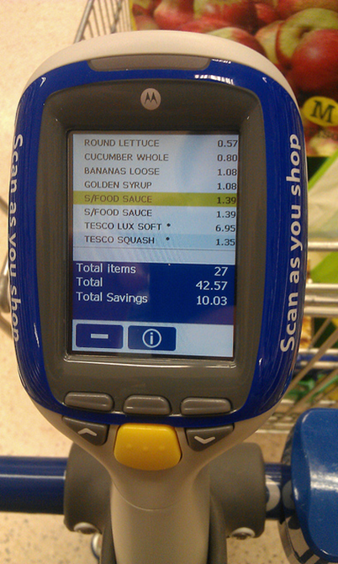




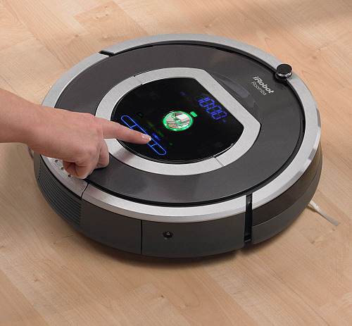
Environment(s)

Slide 14
Environment
Is it an emergency or hazardous environment
Will the users be wearing special clothing, e.g., gloves
Will the users be seated or using the product with one hand etc.
Can environment conditions interfere with the user or product
Any legal requirements/constraints
…
The setting and location of the interaction is important and can influence the design
What do you think you need to know about the user’s environment?

Slide 15
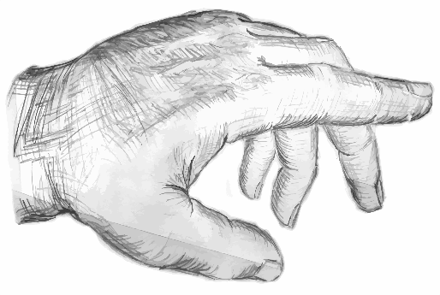
Device interactions
Form: device type, size, used at night/day, screen resolution, constraints…
Posture: posture - consider how much attention is given from user and how the system responds to attention given (e.g., http://www.zeepedia.com/read.php?behavior_form_software_posture_postures_for_the_desktop_human_computer_interaction&b=11&c=26)
Input: mouse, keypad, buttons, touchscreen, voice…
Form
Posture
Input

Slide 16
Design
Users: Models, Affordances, Gestalt principles
Activities
Environment
Goals and Principles

Slide 17
User experience goals
Desirable aspects
satisfying helpful fun
enjoyable motivating provocative
engaging challenging surprising
pleasurable enhancing sociability rewarding
exciting supporting creativity emotionally fulfilling
entertaining cognitively stimulating
Undesirable aspects
boring unpleasant
frustrating patronizing
making one feel guilty making one feel stupid
annoying cutesy
childish gimmicky

Slide 18
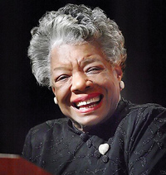
“…people will forget what you said, people will forget what you did, but people will never forget how you made them feel.”
Maya Angelou

Slide 19
Design goals
Safe: the system is not prone to error and allows easy recovery from error
Utilitarian: the systems are functional and the users can access these functions
Effective: the system meets the users’ requirements and expectations
Efficient: the system meets the requirements in the simplest way (save time and money)
Usable: the system is easy to learn and remember

Slide 20
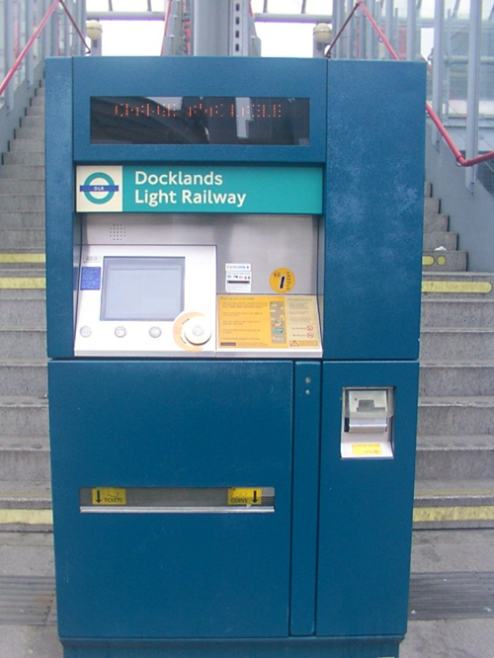
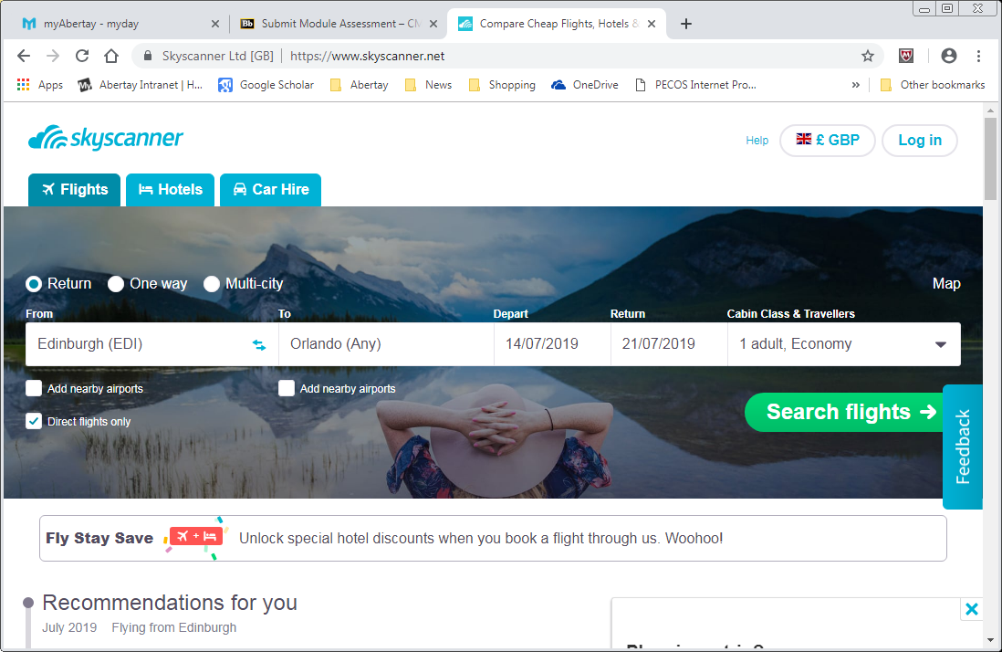
Key design principles
Make clear to the user what the next action should be and what will happen.
Visibility

Slide 21
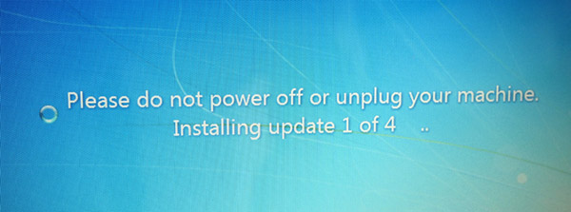
Key design principles
Make it clear to the user that their action is accepted and is being worked on.
Feedback

Slide 22
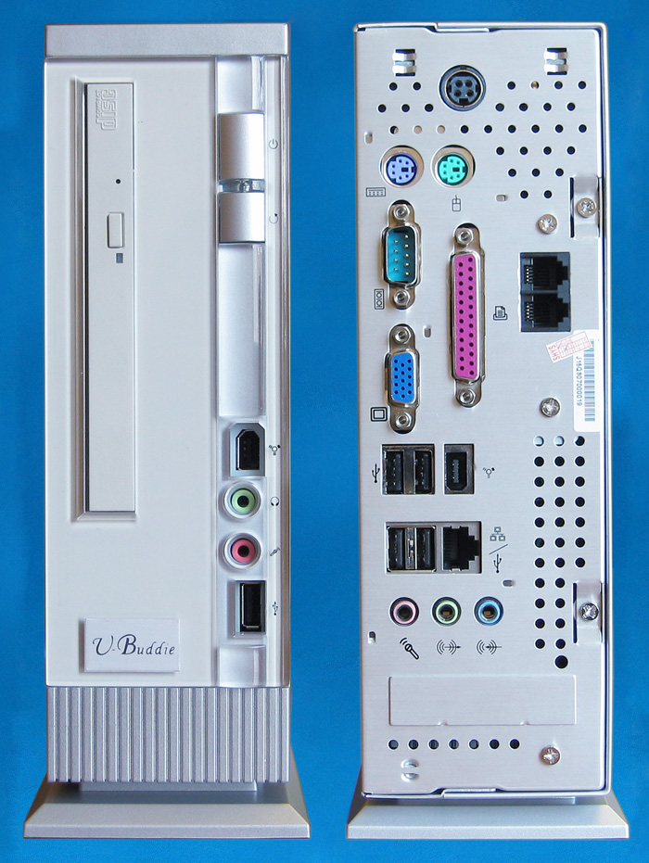
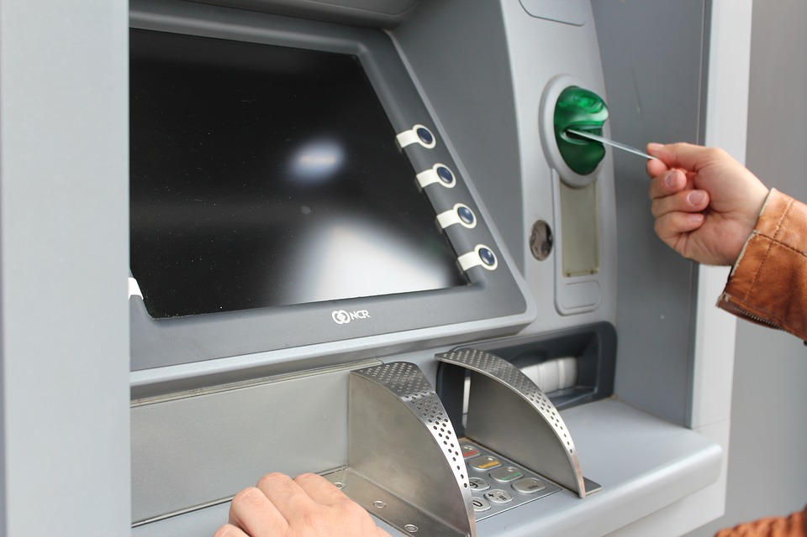
Key design principles
Restrict the possible actions that can be performed using hardware if possible.
(but remember the usb thing…)
Constraints

Slide 23
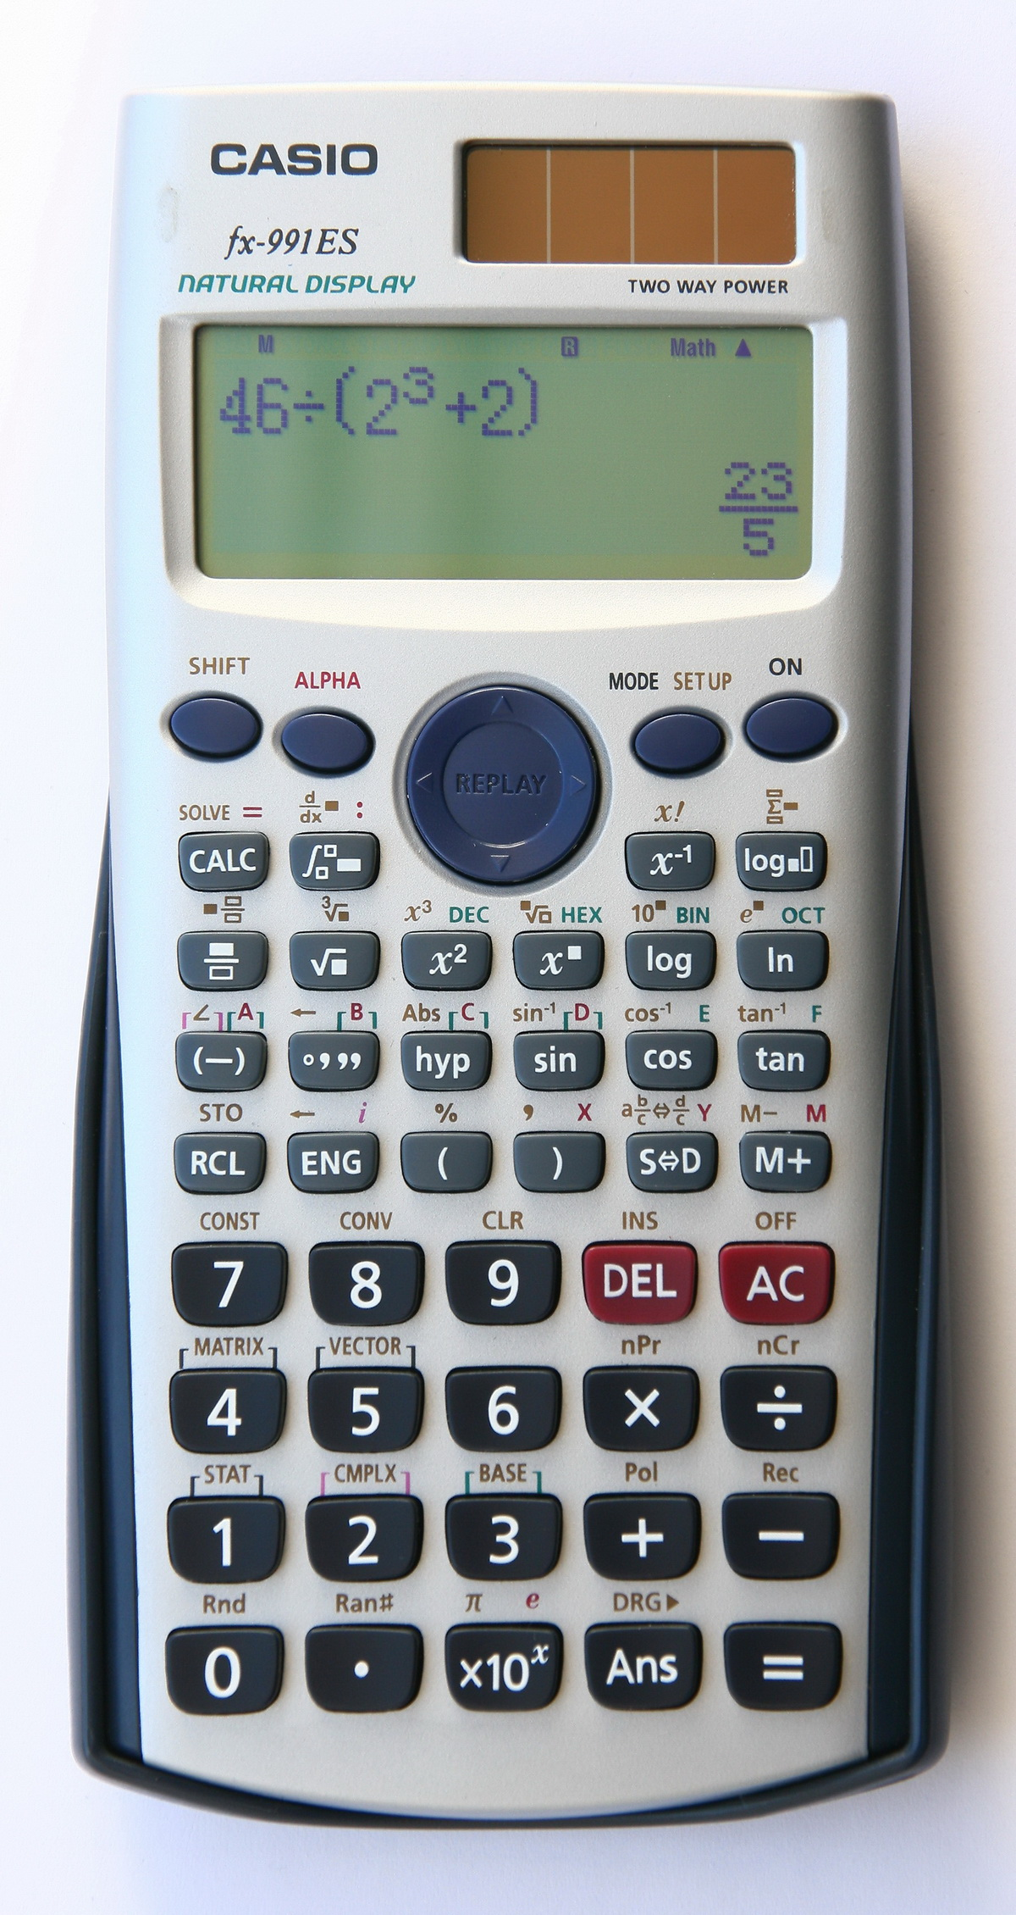
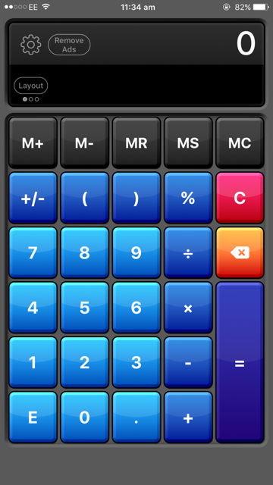
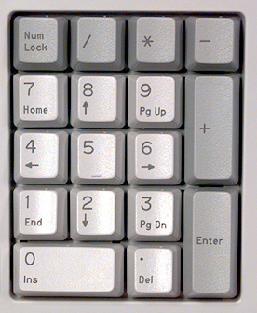
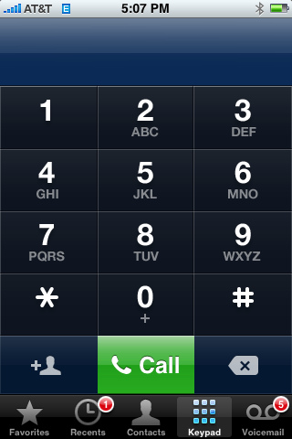
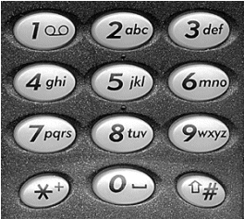
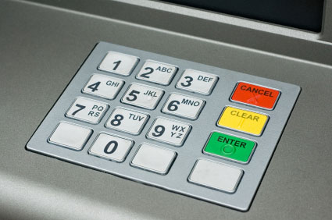
Key design principles
Use similar operations and elements for similar tasks or actions.
Consistency

Slide 24
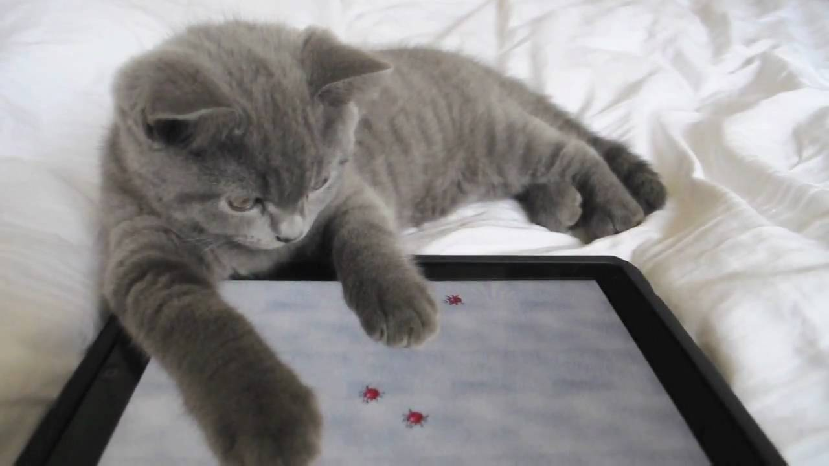
Key design principles
Consider object attributes that allow users to know how to use it.
Ensure that the required actions are in harmony with the users’ expectations.
Affordances

Slide 25
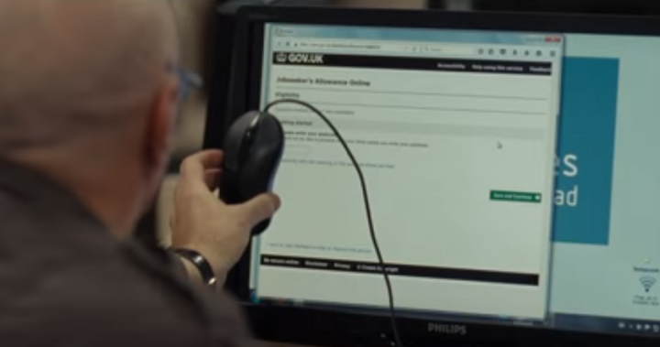
Expectations and mental models
“…just use the mouse to click on the screen.”
“Young children 'try to swipe' pages of books as if they were using a smartphone or tablet”
https://www.gazettelive.co.uk/news/teesside-news/young-children-try-swipe-pages-14485390

Slide 26
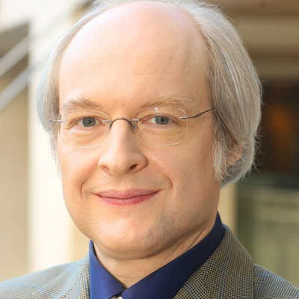
Usability heuristics (Jakob Nielsen)
Visibility of system status
Match between system and the real world
User control and freedom
Consistency and standards
Help users recognize, diagnose and recover from errors
Error prevention
Recognition rather than recall
Flexibility and efficiency of use
Aesthetic and minimalist design
Help and documentation
Similar to the design principles but can form the basis of a checklist for evaluating a design
https://www.nngroup.com/articles/ten-usability-heuristics/

Slide 27
3 Key points
Considering user, activity and environment will clarify what is important in your design and enhance the chances of creating a useful product
User experience and design goals should be considered in your design
Usability principles can guide you in your design, and they can be used as checklists against which to check your design

Slide 28
Next Lecture
Personas, Requirements and Prototypes

